Slide 1
IAC 2023 results

Slide 2
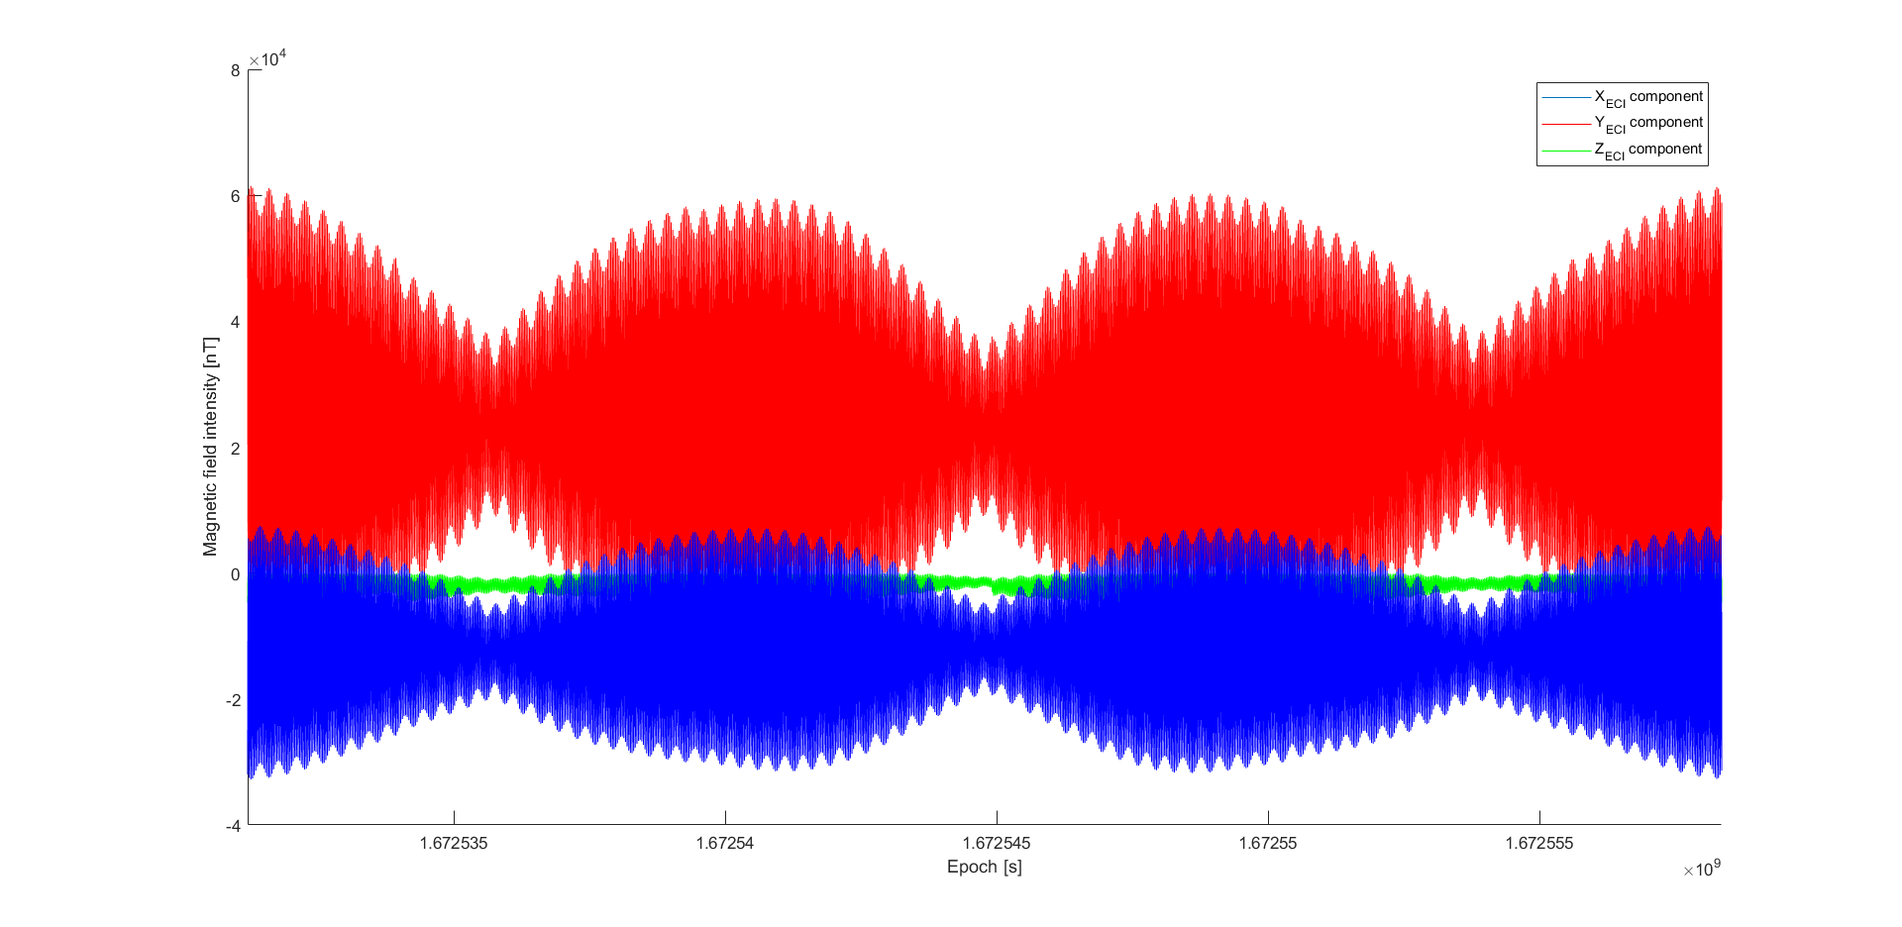
Single spacecraft measurements over time

Slide 3
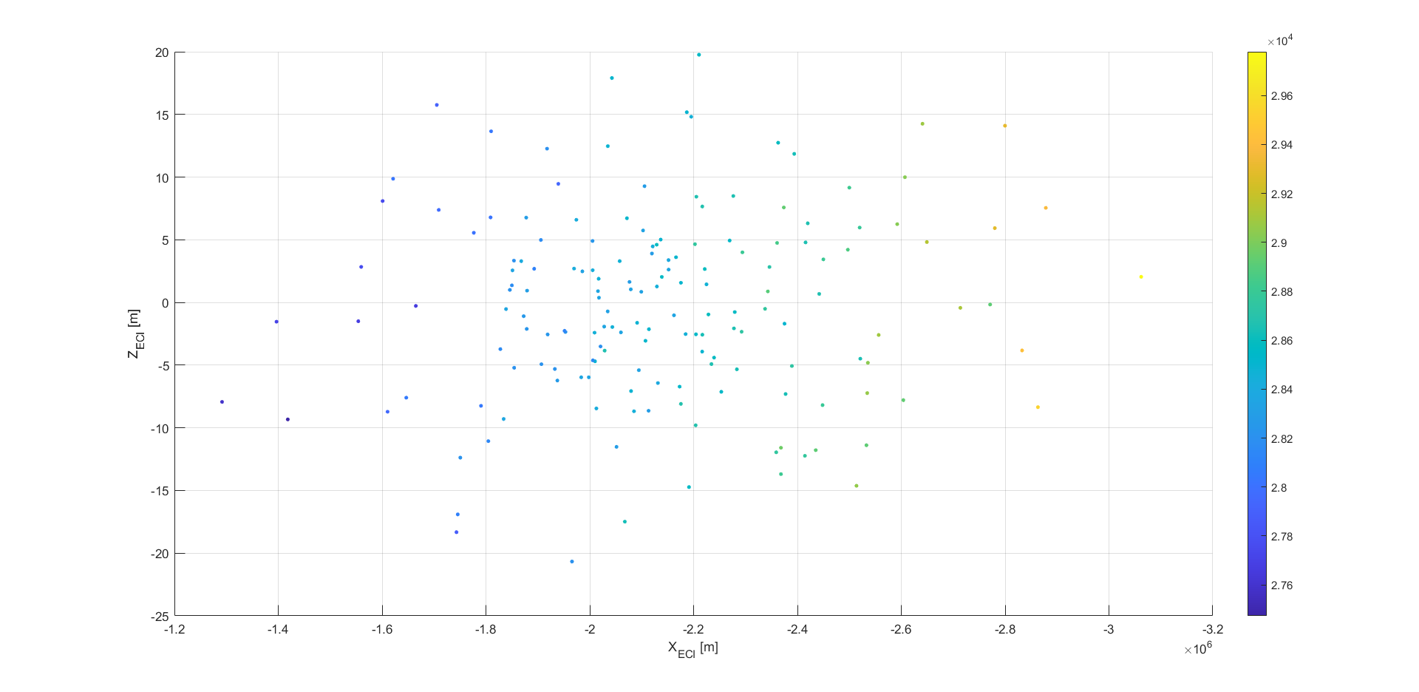
Distributed measurement at fixed time

Slide 4
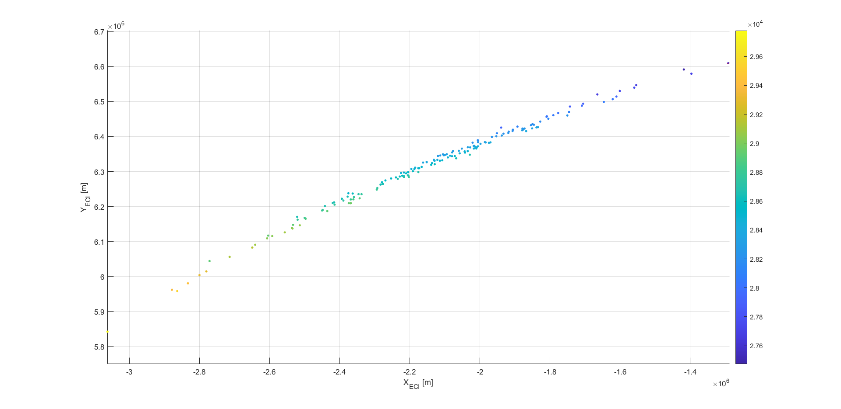

Slide 5
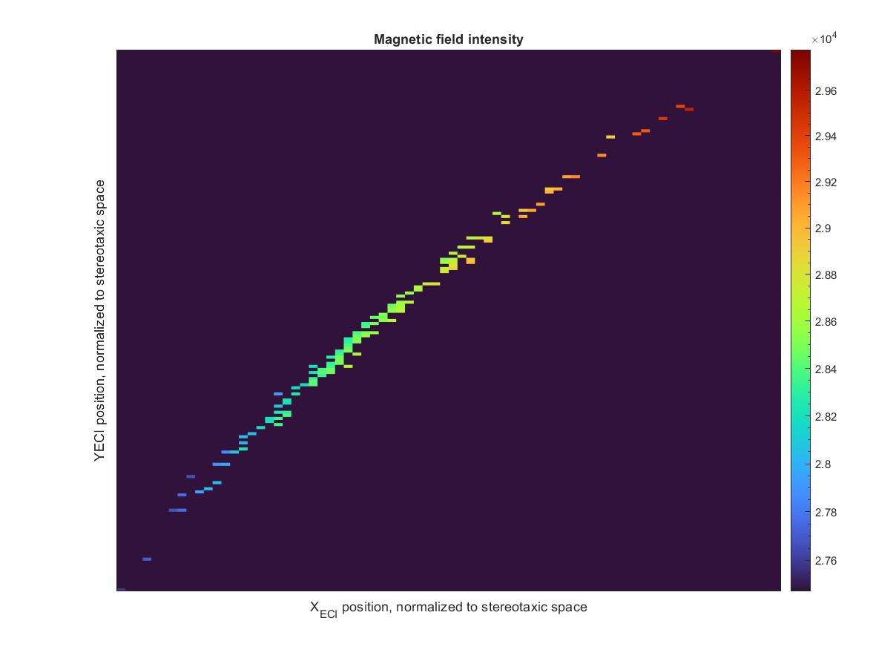

Slide 6
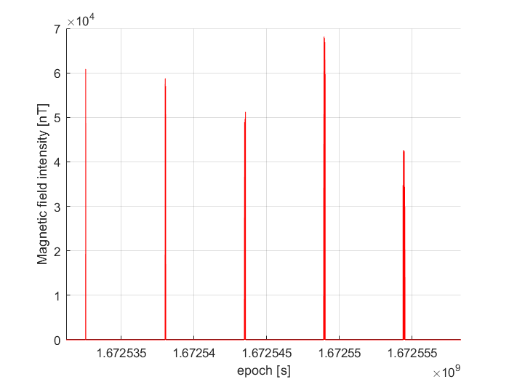
Fixed space measurements over time

